Slide 1



Food & The Stratford Campus
Team Jupiter
Amelia, Alejandra, Agamjot, Bianca, Jeffrey, Kelly, Michael & Renee

Slide 2

Let’s be honest...
Thank you for your honesty!

Slide 3



The Problem
Students need to eat, but not all students know how to cook.
Why?
No time to learn
Procrastination
Lack of Resources

Slide 4

Eloy Becker (User Persona)
19 yrs old
From Oakville
Lives in Stratford for school
Pain Points:
Grocery shopping is time-consuming
Has no time or patience to cook
Can’t cook very well

Slide 5
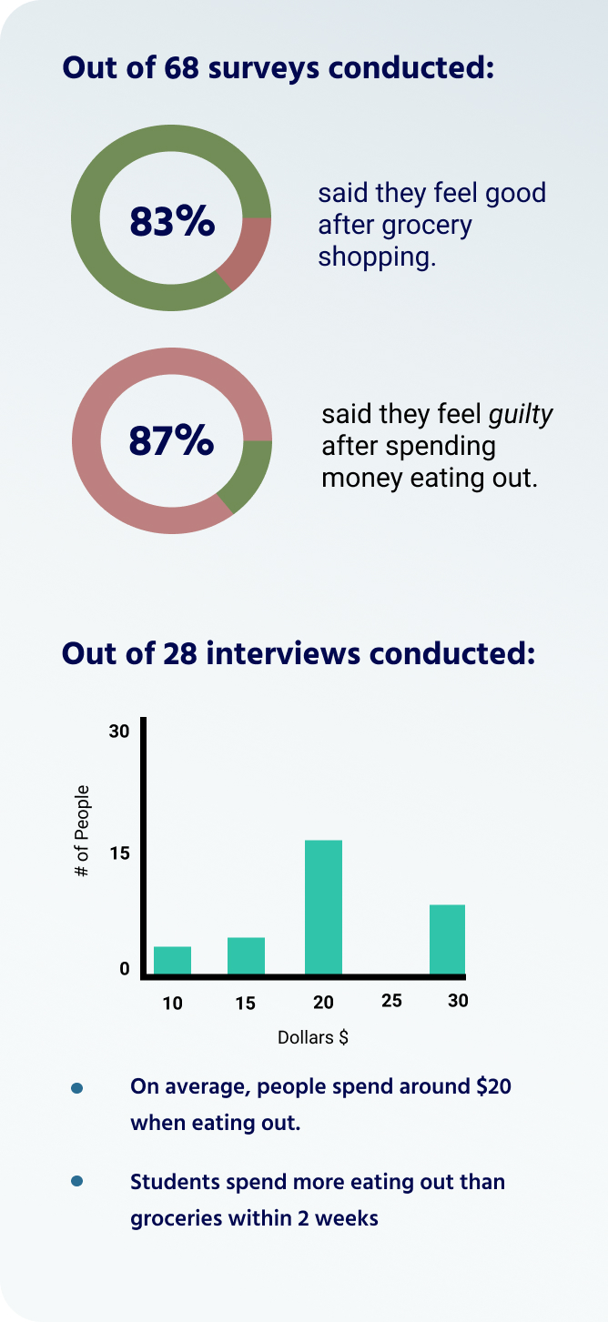
Survey Responses

Slide 6
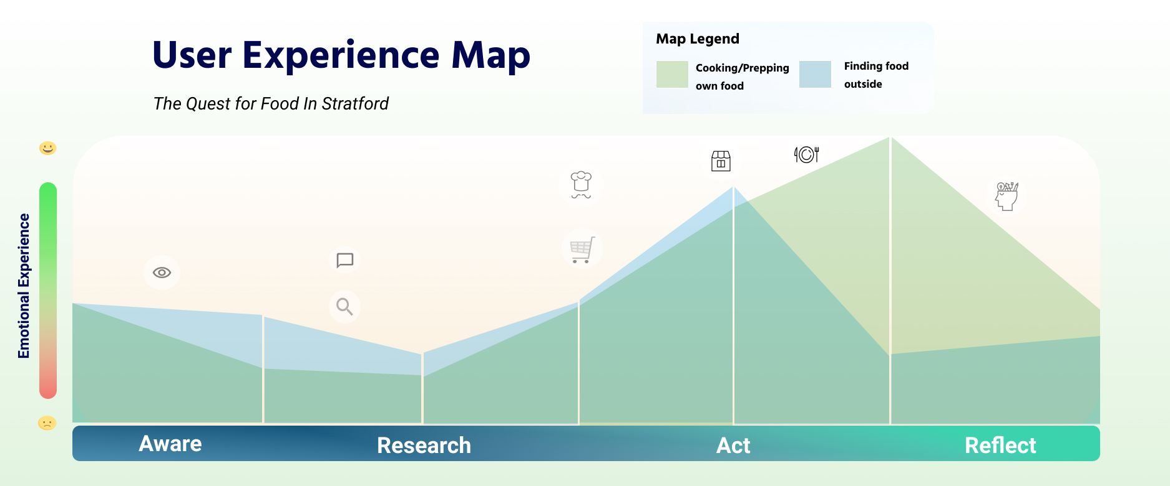

Slide 7
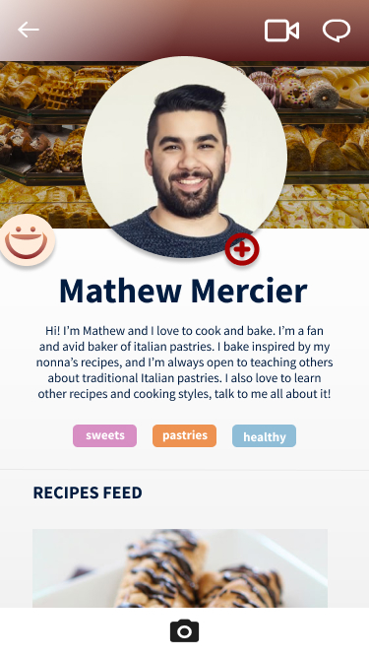
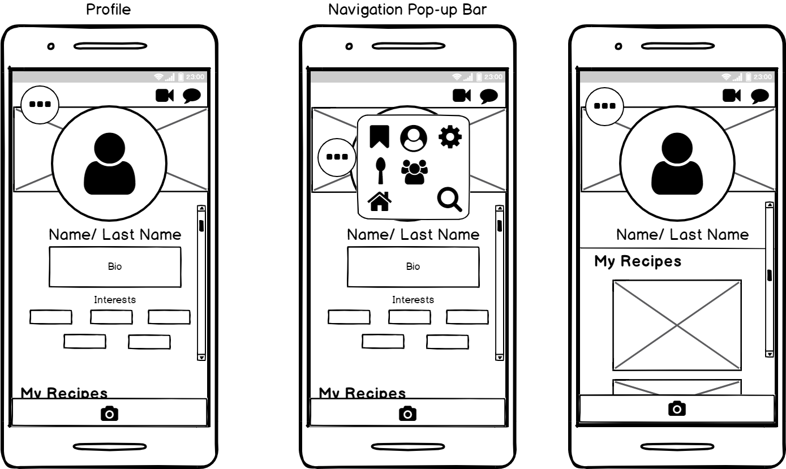
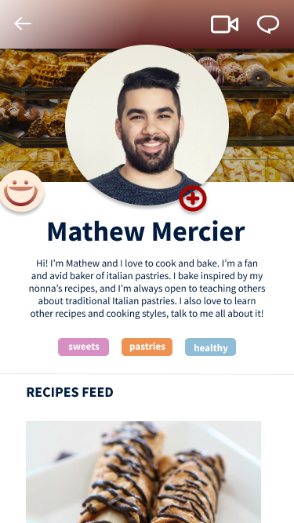
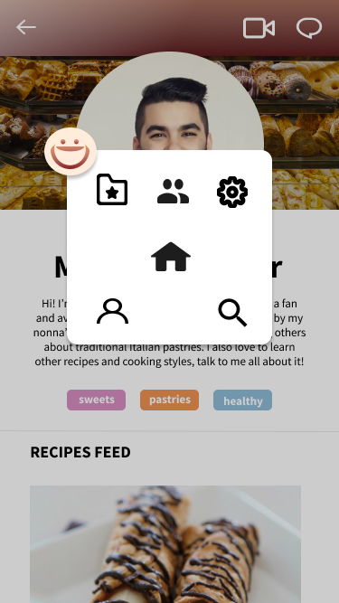
The Solution: A Cooking App

Slide 8
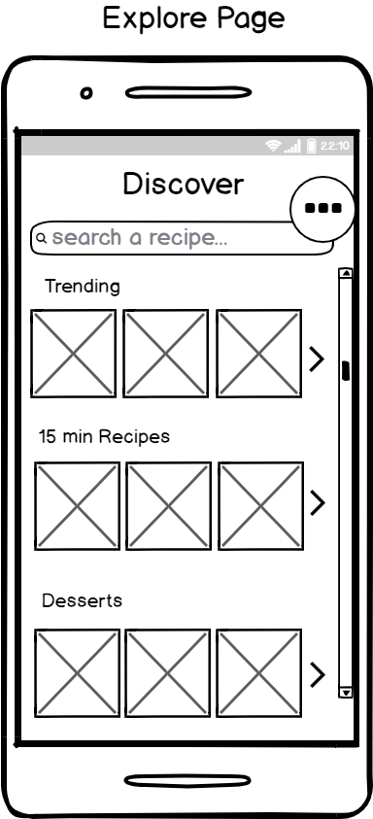
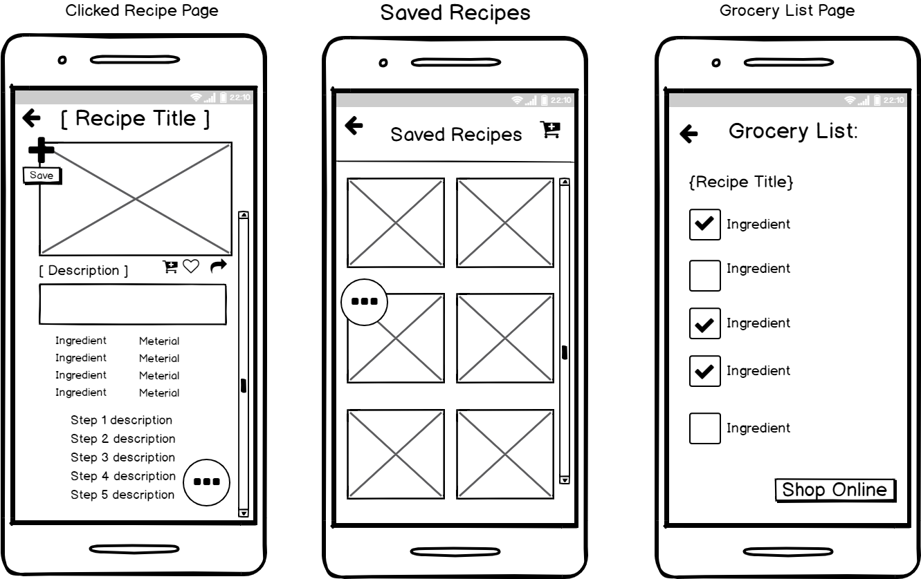

Slide 9
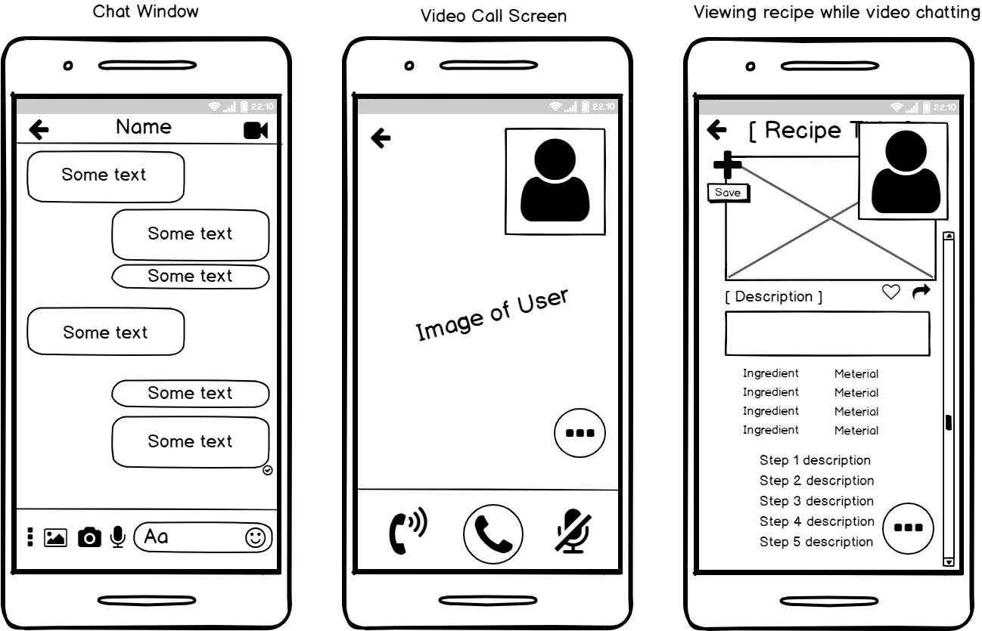

Slide 10
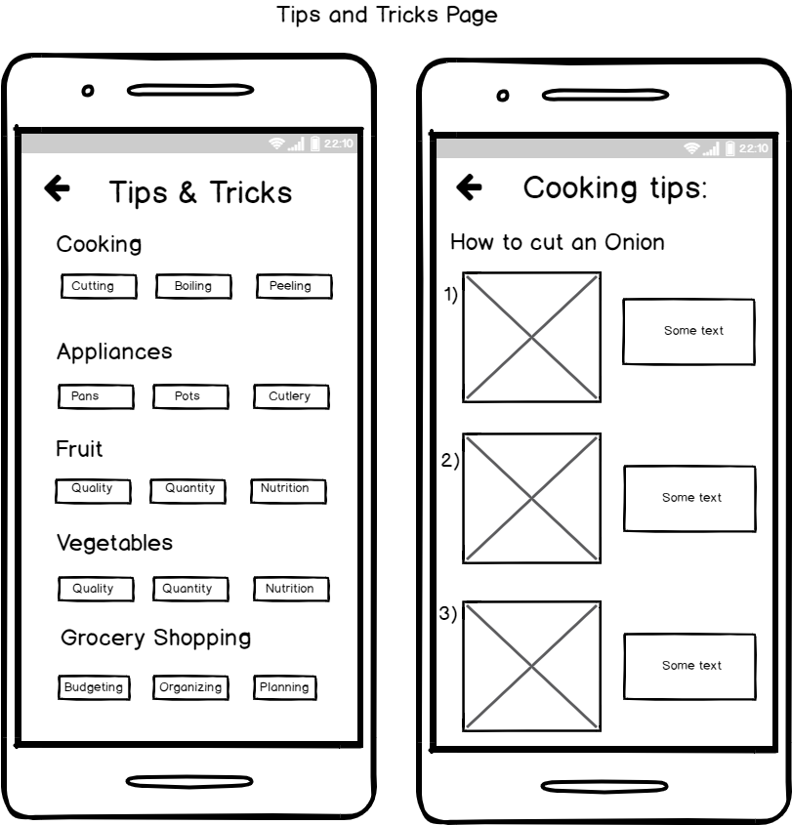

Slide 11



Scenarios
Best Friends Cook together
Father helps his Son

Slide 12

In Conclusion...
Our App solves the problem by:
Teaching users how to cook
Providing them with tips and tricks in the kitchen
Connecting them with others

Slide 13



Thank you for listening!

